Slide 1






Welcome to the Webinar Offered by: National Microelectronics Security Training (MEST) Center
Sponsors:
Notes:
Welcome to the Microelectronics…webinar titled this this
Until 12:03 or send to instructor to have them keep slide for the first 5-8 minutes MEST Logo title and logo name
Uf logo and OSU logo, sponsors AFRL and Nimbis.

Slide 2

MEST Module – 3 Introduction to SoC Modeling with Platform Architect
Christophe Bobda Muhammed Kawser Ahmed Abigail Butka
National Micro Electronics Security Training (MEST) Center

Slide 3
SoC Modeling - Goal
The learning objective of this module is to gain hands-on experience in System-on-Chip modeling with Platform Architect along with peripheral IP integration, AXI and APB bus protocols, and system-level debugging.
In this lab you will use the Synopsys Platform Architect software to build your own SoC.
Synopsys Platform Architect is a SystemC TLM standards-based graphical environment for capturing, configuring, simulating, and analyzing the system-level performance and power of multicore systems and next-generation SoC architectures.
National Micro Electronics Security Training (MEST) Center

Slide 4
SoC Modeling - Motivation
Highlights :
Address the architecture challenges of Artificial Intelligence (AI)-enabled SoCs and multi-chip systems
Hardware-software partitioning and optimization of multicore systems
SoC interconnect and memory subsystem performance and power optimization
Efficient exploration using traffic generation and cycle-accurate TLM interconnect models
Hardware-software validation using cycle-accurate TLM processor models [source: www.synopsys.com]
National Micro Electronics Security Training (MEST) Center

Slide 5
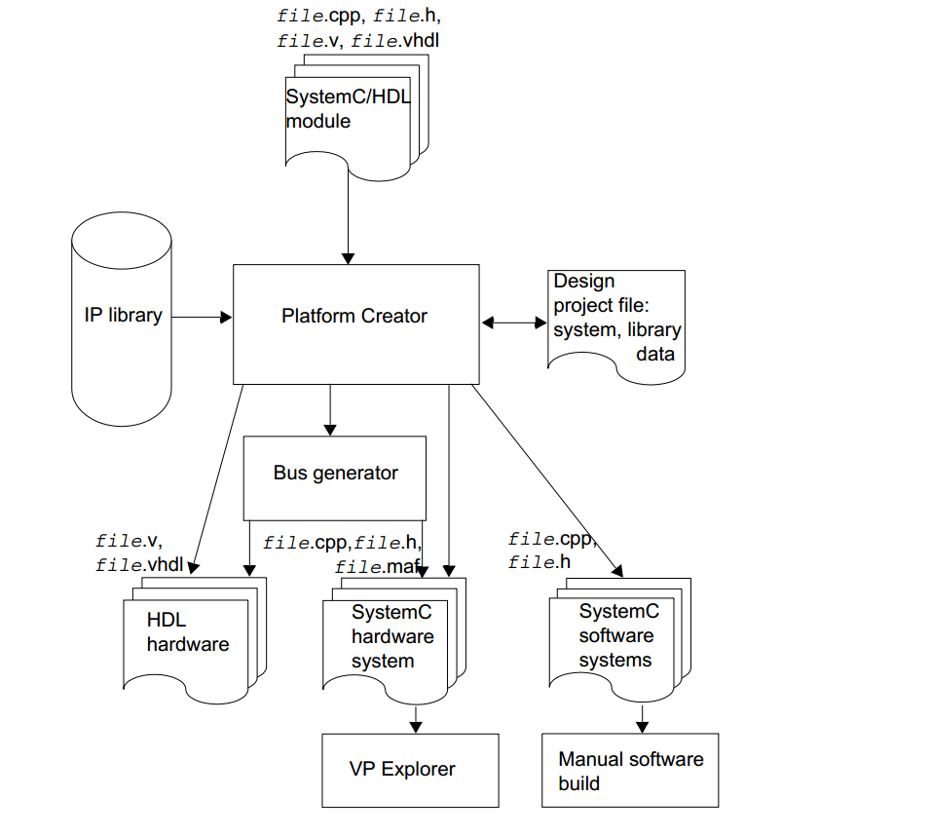
SoC Modeling Flow
The Figure 1 shows the modeling flow of abstracting hardware- software design. The imported SystemC, IP modules and HDL blocks can be combined to create a system.
Figure 1 : Modeling Flow
National Micro Electronics Security Training (MEST) Center

Slide 6
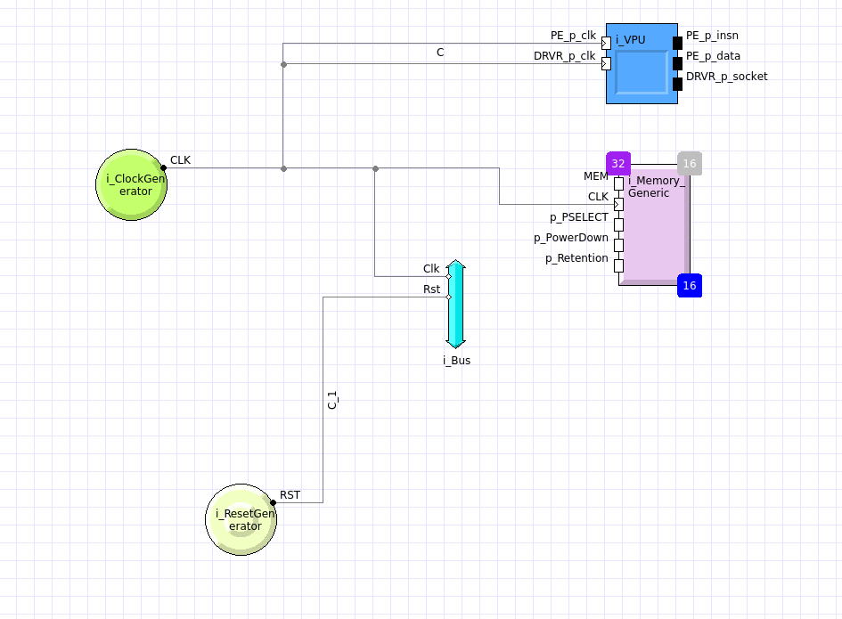
SoC- Design
The SoC Hardware design block includes
1 Virtual Processing Unit (1 VPU)
1 Hardware Ips (Custom HDL)
1 System Bus
1 memory Block
1 clock and reset generator
Equipment's includes:
Synopsys Platform Architect S - 2021.09
Synopsys VCS Compiler
Linux OS
National Micro Electronics Security Training (MEST) Center

Slide 7
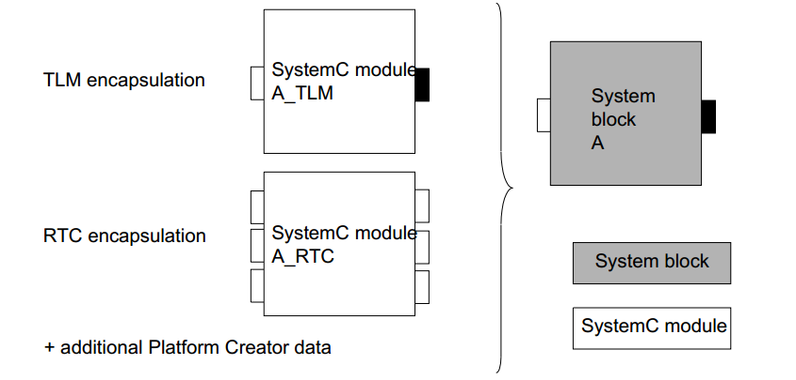
Platform Architect – Blocks and Encapsulation
All the blocks in Platform Architect can be divided into four elements:
1. Blocks - Blocks are used to represent the SystemC Modules 2. Buses - Buses serve as the foundational components of bus architecture and are delineated within a specific bus library, such as the AMBA® Bus Library, which encompasses nodes like AHB, APB, input-stage, and output-stage buses.
3. Bridges - Bridges facilitate conversions, such as protocol and addressing mode adjustments, within connections linking bus nodes and between system blocks and bus nodes.
4. Hardware-software interfaces: A hardware-software interface entails the implementation of communication between hardware and software components.
National Micro Electronics Security Training (MEST) Center

Slide 8
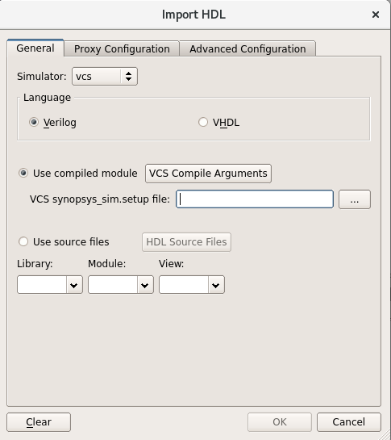
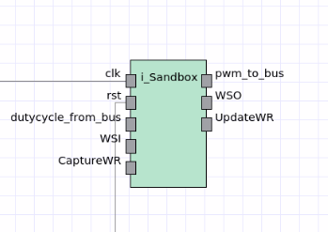

Platform Architect – Adding Custom IP
In platform Architect we can add HDL based custom sytem IP or block. The Import HDL wizard can be found in the menu bar by selecting
Project-> Import HDL. This window allows us to import HDL from either Verilog or VHDL. Additionally, we can specify the compiled module instead of the source HDL files. The simulator options are vcs, mti or ncsim. Clicking HDL source files button will open the Compile HDL source files window where the user can specify the paths of the source files including compile arguments.
National Micro Electronics Security Training (MEST) Center

